Slide 1



IEEE
Texas State IEEE Student Branch
OPS project #5

Slide 2


Today’s project is Pitch Perfect
demo

Slide 3
Session Goals
By the end of today, students will:
Understand the difference between digital and analog inputs
- Learn how a potentiometer works as a voltage divider
- Use analogRead() and map() to convert a sensor reading into a useful range
- Use tone() and noTone() to drive a piezo buzzer at different frequencies
- Build a working pitch controller that plays a note only while the button is held

Slide 4
New part: Potentiometer
What is it?
- A knob that slides a contact along a resistor.
A voltage divider: 0 V one end, 5 V the other.
How to wire it:
- Outler legs -> 5V and GND
Middle leg -> A# (Any Analog GPIO)
How to wire it:
- analogRead(A#); -> 0 to 1023
- map(); -> turns the Read into a frequency
10 kΩ
5V
A0
GND
outer leg
wiper
outer leg
Turn the knob → the middle pin moves from 0 V to 5 V → analogRead gives 0–1023

Slide 5
Good Terms to Know
Mapping (map())
A function that converts a number from one range into another range.
The knob gives 0 to 1023, but the buzzer needs a pitch in hertz (Hz), like 100 to 2000.
map(potValue, 0, 1023, 100, 2000) stretches one range to fit the other, so halfway on the knob is about halfway up the pitch range.
Analog Input
A signal that can be any value in a range, not just on or off like a button.
analogRead() measures the voltage on an analog pin (0 to 5 V) and turns it into a number from 0 to 1023.
Turning the potentiometer changes that voltage, which is how the knob controls the pitch.

Slide 6
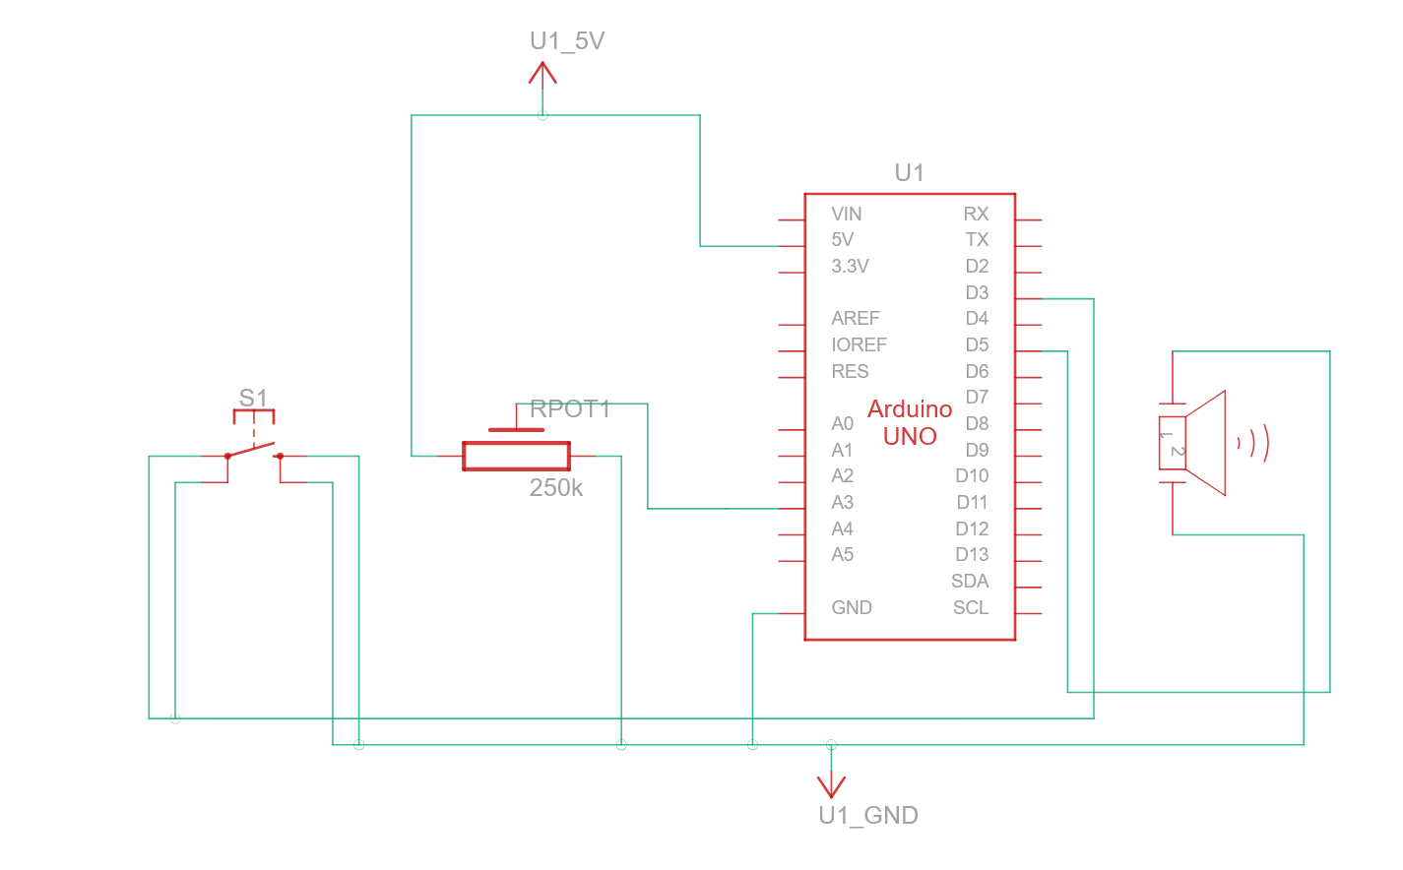
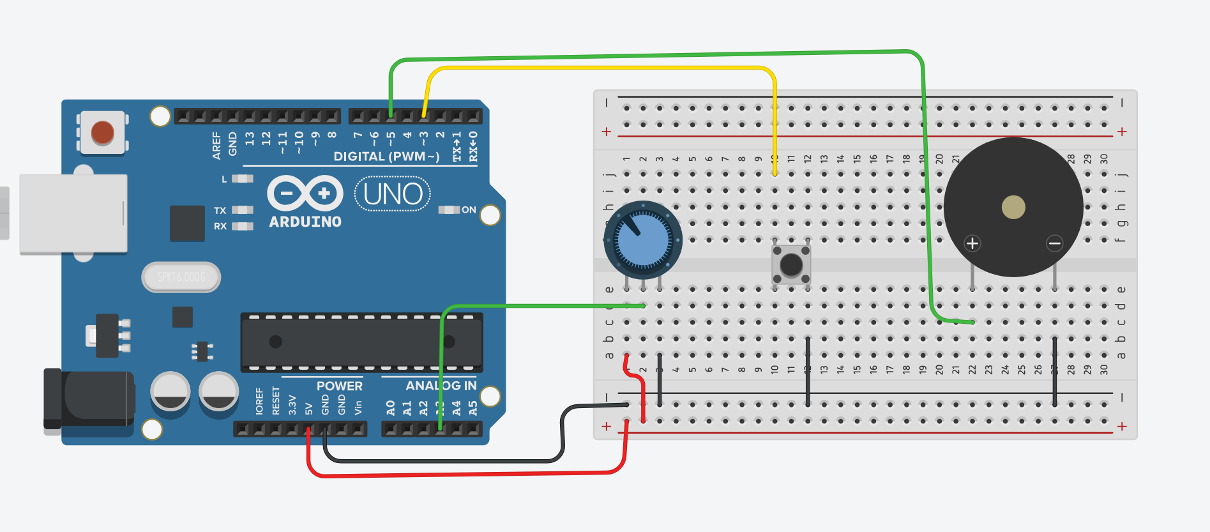
Circuit diagrams

Slide 7
Pseudocode
// Create three constants:
// Choose a frequency range
void setup() {
// Set up the pins and Serial
}
void loop() {
// Read the knob and convert it to a frequency
// use analogRead()
// use map()
// Play or stop based on the button
// - if the button reads LOW make sound, otherwise don’t.
// Print the values
// - print the pot value and the frequency to the Serial Monitor
// - add a short delay
}

